Slide 1
Setup
Open these slides @ http://ap.pn/2myptQi
Skip the setup with CodeSandbox: http://ap.pn/2lGZ07W (styling may not work)
OR
Download and install Node.js with the defaults: https://nodejs.org/en/download/
Note: Windows users may use the Node.js command prompt
Download and unzip the starter project: http://ap.pn/2ynVJR6
For Github instructions, click here
Download and install the latest version of Sublime (or preferred editor): https://www.sublimetext.com/
Open Sublime or IDE of choice (remaining steps are optional)
Install “Package Control” and “Babel”
Change the syntax highlighting to Javascript (Babel)
View > Syntax > Babel > Javascript (Babel)
Go to File > Open... > select the starter project folder

Slide 2

React Messaging App
(C) 2017 Appian Corporation. Distribution with attribution permitted. All other rights reserved
Notes:
Introduce Everyone

Slide 3
Why is React Useful?

Slide 4


What is React - Components and the DOM
Chat Box
👺
😈
🐼
🐵
🐼
💩
👻
Send
Notes:
Let’s say you have a complex view, with lots of different entry points (like facebook’s UI, or Appian’s).
We are going to refer to this UI in the browser as the DOM (Document Object Model).

Slide 5
What is React - Updating the UI
Chat Box
1
🐼
1
👺
🐼
🐵
🐼
💩
👻
Send
Notes:
Keeping the state of your UI consistent quickly becomes a challenge! Making a post should put the new post on the screen, sending notifications to others and updating the list of people you have messages with.

Slide 6
What is React - Centralized Logic for the View
Chat Box
1
State
🐼
1
👺
🐼
🐵
🐼
💩
👻
Send
Notes:
React simplifies this by centralizing where your ‘logic’ for the view lives.

Slide 7
What is React - Rebuilding the UI
Chat Box
1
State
🐼
1
👺
🐼
🐵
🐼
💩
set state
👻
New message
Send
Notes:
Rather than views modifying other views, they instead change the central logic which triggers a rebuild of the whole UI with the new data.

Slide 8
What is React - Re-Rendering
Database
Chat Box
State
🐼
🐼
re-render
👺
🐼
🐵
💩
set state
👻
Send
Notes:
Rather than views modifying other views, they instead change the central logic which triggers a rebuild of the whole UI with the new data.

Slide 9
What is React - Re-Rendering
Chat Box
State
🐼
🐼
👺
🐼
🐵
set state
💩
React.js
Virtual DOM
👻
Send
re- render
Notes:
Now, this sounds pretty expensive, to mitigate this React takes the View that you build and diffs it against what is currently on the screen and only updates the parts of the UI that changed.
This is called the React lifecycle

Slide 10
Setup
Open these slides @ http://ap.pn/2myptQi
Skip the setup with CodeSandbox: http://ap.pn/2lGZ07W (styling may not work)
OR
Download and install Node.js with the defaults: https://nodejs.org/en/download/
Note: Windows users may use the Node.js command prompt
Download and unzip the starter project: http://ap.pn/2ynVJR6
For Github instructions, click here
Download and install the latest version of Sublime (or preferred editor): https://www.sublimetext.com/
Open Sublime or IDE of choice (remaining steps are optional)
Install “Package Control” and “Babel”
Change the syntax highlighting to Javascript (Babel)
View > Syntax > Babel > Javascript (Babel)
Go to File > Open... > select the starter project folder

Slide 11
Dependencies and Builds
Run npm install in the command line from the root of your project.
This will download all the dependencies that are in your package.json file.
Notes:
On Windows you will run the command in the Node js Command Prompt that was installed with Node.js
On mac and linux you can use the command prompt

Slide 12



Setup - Dependencies and Builds
Libs
Output Files:
js, html, css
Our Code
Notes:
This diagram describes the flow and tools that we use for building our project. And returning code a browser can handle.
npm (Node.js Package Manager) - takes care of getting your project dependencies
Our code
Webpack - A JS library that builds your project, and hosts it (locally)
package.json - tells npm which dependencies your project needs (also defines build targets)
webpack.config.js - Tells Webpack how to build your project
Computer Image from Perhelion, licensed under CCA-Share Alike 3 from Wikimedia

Slide 13

Setup - Dependencies and Builds
index.js
index.html
package.json
webpack.config.js
App.jsx
main.js
index.html
Notes:
Here are the different files we will be writing and where they fall in this process
Package.json is used for configuring npm and what it pulls
Webpack.config.js controls how webpack builds our project
Babel - a library for compiling jsx into js that will work on any browser.
And our code and the outputs of webpack. (next slide)

Slide 14

Setup - Key Files to Success
App.jsx: Our first React component! It's the entry point for the application.
main.js: Calls our React code. Webpack turns this file into index.js for the browser to load.
index.html: The HTML that defines the content of the web page. It loads the JavaScript from index.js.
main.js
index.html
App.jsx
index.js

Slide 15
Interlude - Files Breakdown
App.jsx
Each JSX file in our application will have 3 major sections:
Imports
Class
Exports
import React from 'react';
import Firebase from './firebase-wrapper';
class App extends React.Component {
constructor() {}
render() {}
}
export default App;

Slide 16
Files Breakdown - Imports
Imports bring other modules into this file so we can use them.
We import React so we can make a React class in this file
We import Firebase so we can make calls to our server
App.jsx
import React from 'react';
import Firebase from './firebase-wrapper';
class App extends React.Component {
constructor() {}
render() {}
}
export default App;

Slide 17
Files Breakdown - Class
Classes Instantiation:
Function structure:
App.jsx
class X extends ...
import React from 'react';
import Firebase from './firebase-wrapper';
class App extends React.Component {
constructor() {}
render() {}
}
export default App;
funcName() {
<content>
}
Notes:
React.createClass is deprecated in the newest version of React.

Slide 18
Files Breakdown - Exports
Exports allow other modules to reference this class.
App.jsx
import React from 'react';
import Firebase from './firebase-wrapper';
class App extends React.Component {
constructor() {}
render() {}
}
export default App;

Slide 19
Chat Box
All web pages are made out of modular components.
Our application:
The Application
Messages
The Input Box
Corresponding classes:
App.jsx
Message.jsx
Input.jsx
🐼
🐼
👺
🐵
💩
👻
Send

Slide 20
React Component Lifecycle
Mounting (Creating)
Updating
Unmounting (Destroying)
constructor
componentWillReceiveProps
componentWillUnmount
componentWillMount
shouldComponentUpdate
true
false
componentWillUpdate
render
render
componentDidMount
componentDidUpdate
Docs for the lifecycle methods
Notes:
React’s component lifecycle allows us to have more control over the stages that a component goes through in a predictable manner. Don’t worry about all of these methods - we will get to the relevant ones through our exercise, and this diagram is useful for seeing all the methods that are available for use.

Slide 21
// Import React and other stuff
import React ....
class App extends React.Component{
constructor(props) {
super(props);
this.state = {
messages: [] // Initialize empty list of messages
};
}
componentWillMount() {
// Turns on Firebase
}
componentWillUnmount() {
// Turns off Firebase
}
render() {
// shows your HTML/JSX content on the screen
}
}
export default App;
App.jsx
Mounting (Creating)
constructor
componentWillMount
render
componentDidMount

Slide 22
// Import React and other stuff
import React ....
class App extends React.Component{
constructor(props) {
super(props);
This.state = {
messages: [] // Initialize empty list of messages
};
}
componentWillMount() {
// Turns on Firebase
}
componentWillUnmount() {
// Turns off Firebase
}
render() {
// shows your content on the screen
}
}
export default App;
App.jsx
Updating
componentWillReceiveProps
shouldComponentUpdate
true
false
componentWillUpdate
render
componentDidUpdate

Slide 23
// Import React and other stuff
import React ....
class App extends React.Component{
constructor(props) {
super(props);
This.state = {
messages: [] // Initialize empty list of messages
};
}
componentWillMount() {
// Turns on Firebase
}
componentWillUnmount() {
// Turns off Firebase
}
render() {
// shows your content on the screen
}
}
export default App;
App.jsx
Unmounting (Destroying)
componentWillUnmount
Notes:
Kills the connection to the server

Slide 24
Let’s Jump Right In
Notes:
Emphasize that we want people to follow along more than typing along during the workshop

Slide 25
Let’s run our app!
Once npm install has installed all your packages, we can run npm run start from the command line. This will deploy our project.
Go to localhost:8081 in your browser to see your app!
Notes:
Stop for 1-2 minutes to ask for questions or wait for them to catch up

Slide 26
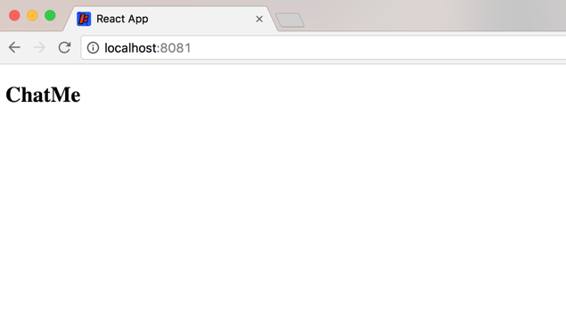
Let’s run our app!

Slide 27
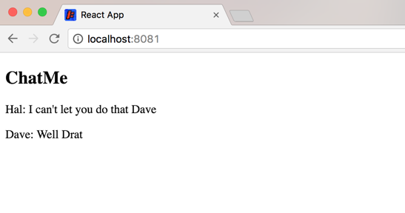
Showing the Messages

Slide 28
Showing the Messages
We are going to use a mock database source and later Firebase to host the messages for our chat application.
First, let’s display the pre-recorded messages from our database.
See the changes here!

Slide 29
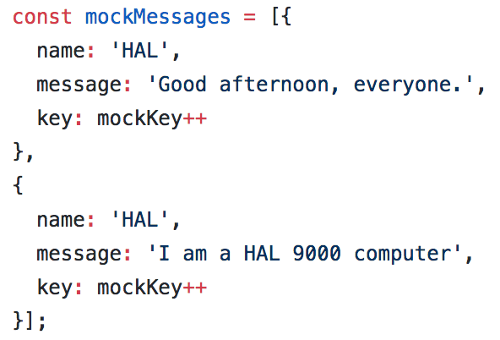
Where Are the Messages Coming From?
The messages are mocked in firebase-wrapper.js
Before the App mounts on the DOM, we turn on Firebase and it will pre-populate these messages for us

Slide 30
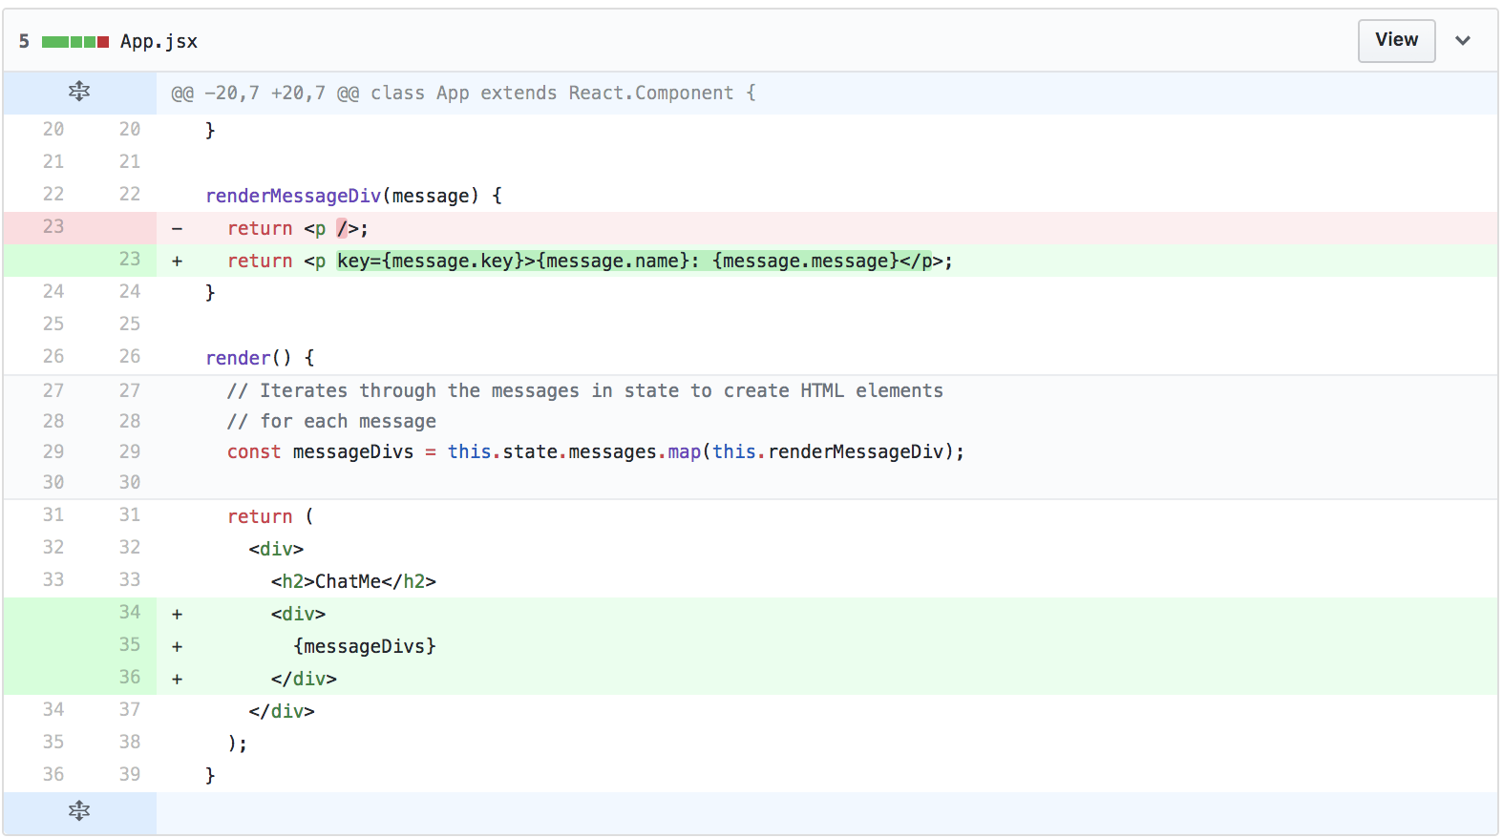
Showing the Messages
Red lines should be removed
Green lines should be added
Each message has fields called: name, message, and key
message: {
name: ‘HAL’,
message: ‘I am a HAL 900 computer’,
key: mockKey ++
}

Slide 31
Common React/JS mistakes and Best Practices
Syntax errors, like missing , . ; { or (
Mixing up , with . OR ( with {
Misspellig or mis-caSing variable names
Missing keywords like var, const, let or import
Notes:
Link to handout: https://docs.google.com/document/d/1PFxSwu9vYmv1dOBGvVwo4xHQJ82-fv8E83LvsqO2VqQ/edit

Slide 32
Interlude - Const, Let, Var
const | Variable is instantiated once and cannot be changed.
let | Variable can be changed and is scoped to the nearest enclosing block
var | Variable can be changed and scoped to the nearest function block

Slide 33


Interlude - Scoping
function() {
if (true) {
let b = 'b';
var c = 'c';
console.log(b);
console.log(c);
}
console.log(b);
console.log(c);
}

Slide 34
Making A Component
You can make React components to modularize the UI
We are going to make each message a component
See the changes here!
Notes:
While having each message as a component may not have a lot of value right now, it will be helpful to see how we make React components and we’ll add some more complex logic later on.
Go over why components are useful

Slide 35
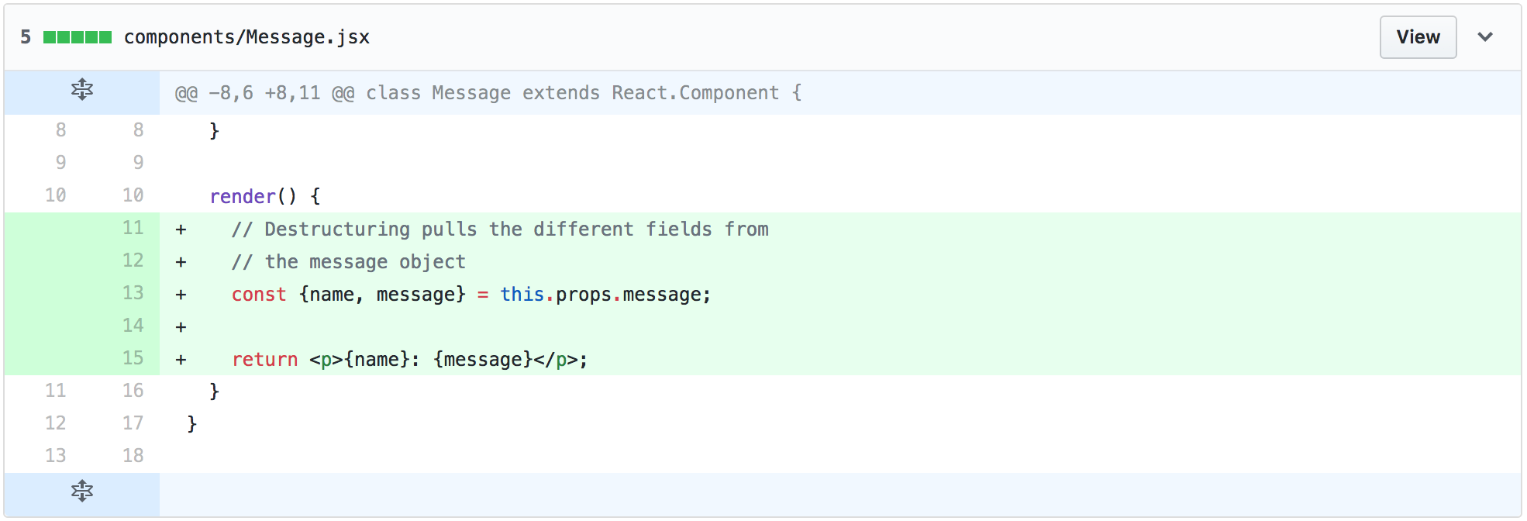
Making A Component
Notes:
While having each message as a component may not have a lot of value right now, it will be helpful to see how we make React components and we’ll add some more complex logic later on.

Slide 36
The this Keyword
What is this?!
This is a way to access different variables and methods that are bound to your component. It's essentially a reference to the class itself!
For now, we're only accessing variables in the props. Later, you'll see us access functions defined in the component.
Other Examples:
this.myFunction = this.myFunction.bind(this);
this.setState({name: 'Some Value'});

Slide 37
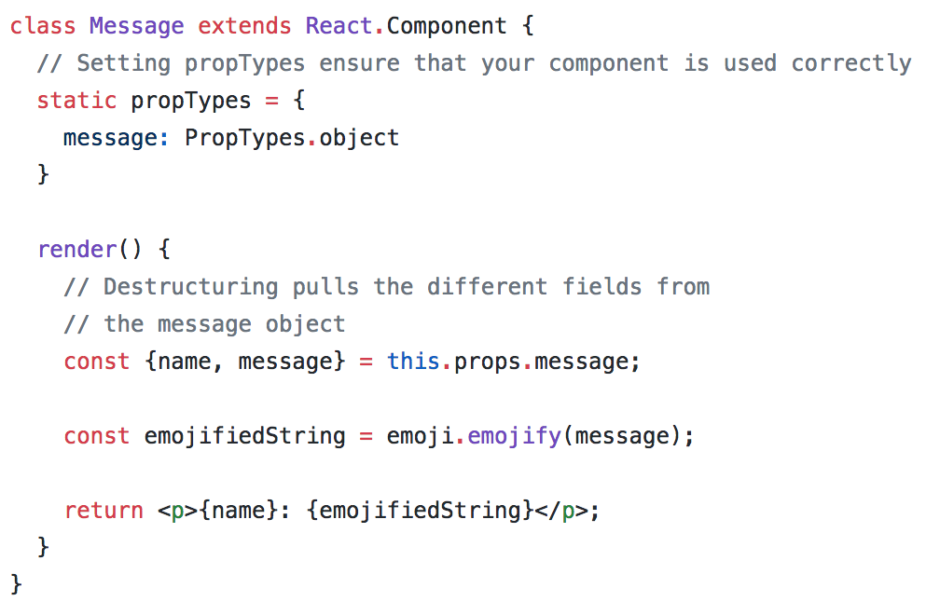
The Props
Props are values that are passed into a component from a parent component
They are immutable, static fields on the component’s class
Each class must define its props and their types in the following format:
static propTypes = {
<prop name>: <variable type>,
<prop name>: <variable type>,
...
}

Slide 38
Destructuring Assignments
const {name, message} = this.props.message;
is the same as:
const name = this.props.message.name;
const message = this.props.message.message;

Slide 39
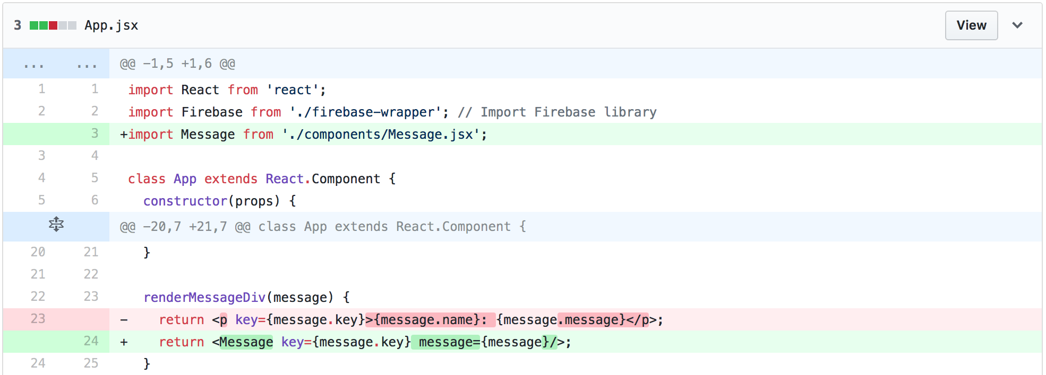
Making A Component - Integration
Notes:
While having each message as a component may not have a lot of value right now, it will be helpful to see how we make React components and we’ll add some more complex logic later on.

Slide 40
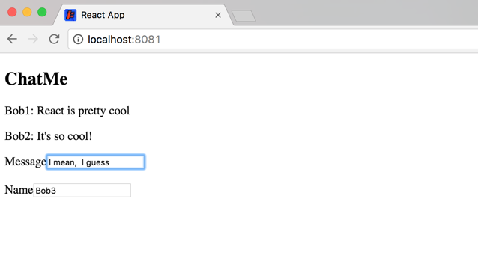
Adding new Messages

Slide 41
Adding New Messages
For both name and message we need both an input and a label
Our message will be sent to the server when we hit Enter, then the message field will be cleared.
See the changes here!

Slide 42
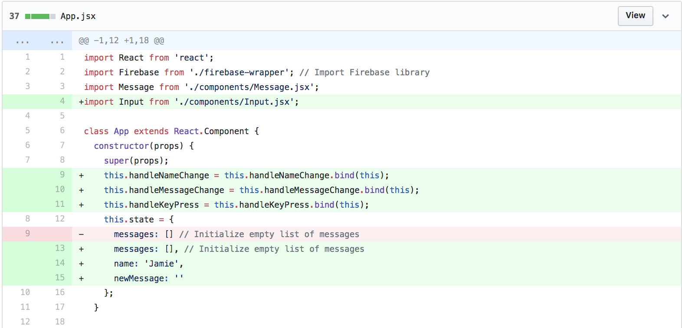
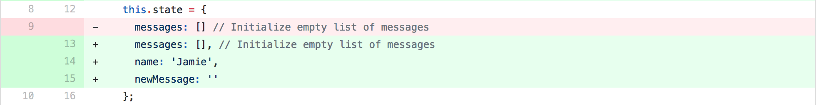
Adding New Messages

Slide 43
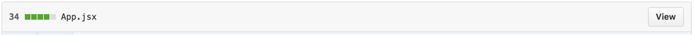
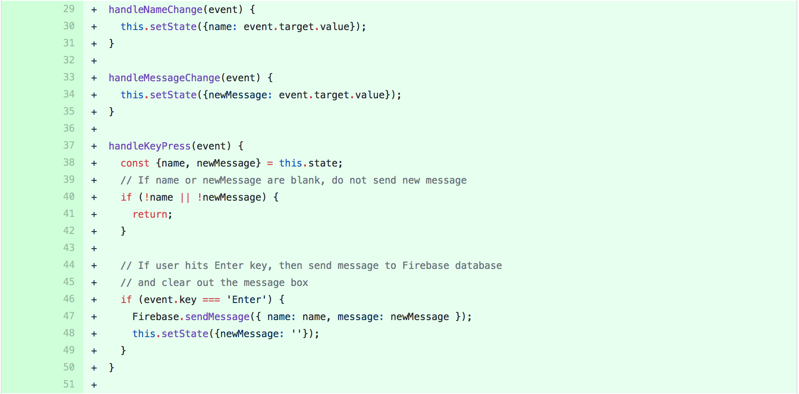
Adding New Messages

Slide 44
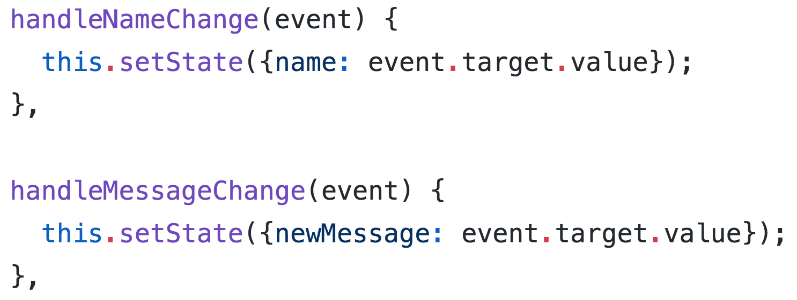
Adding New Messages - Changing State
Change state variables with:
Calling this function causes the component to re-render
this.setState({
name: value
})

Slide 45
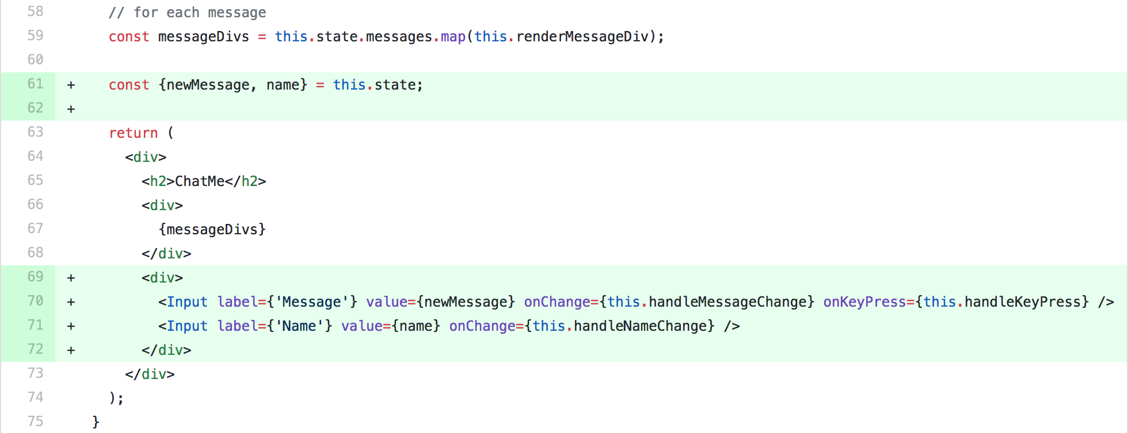
Adding New Messages

Slide 46
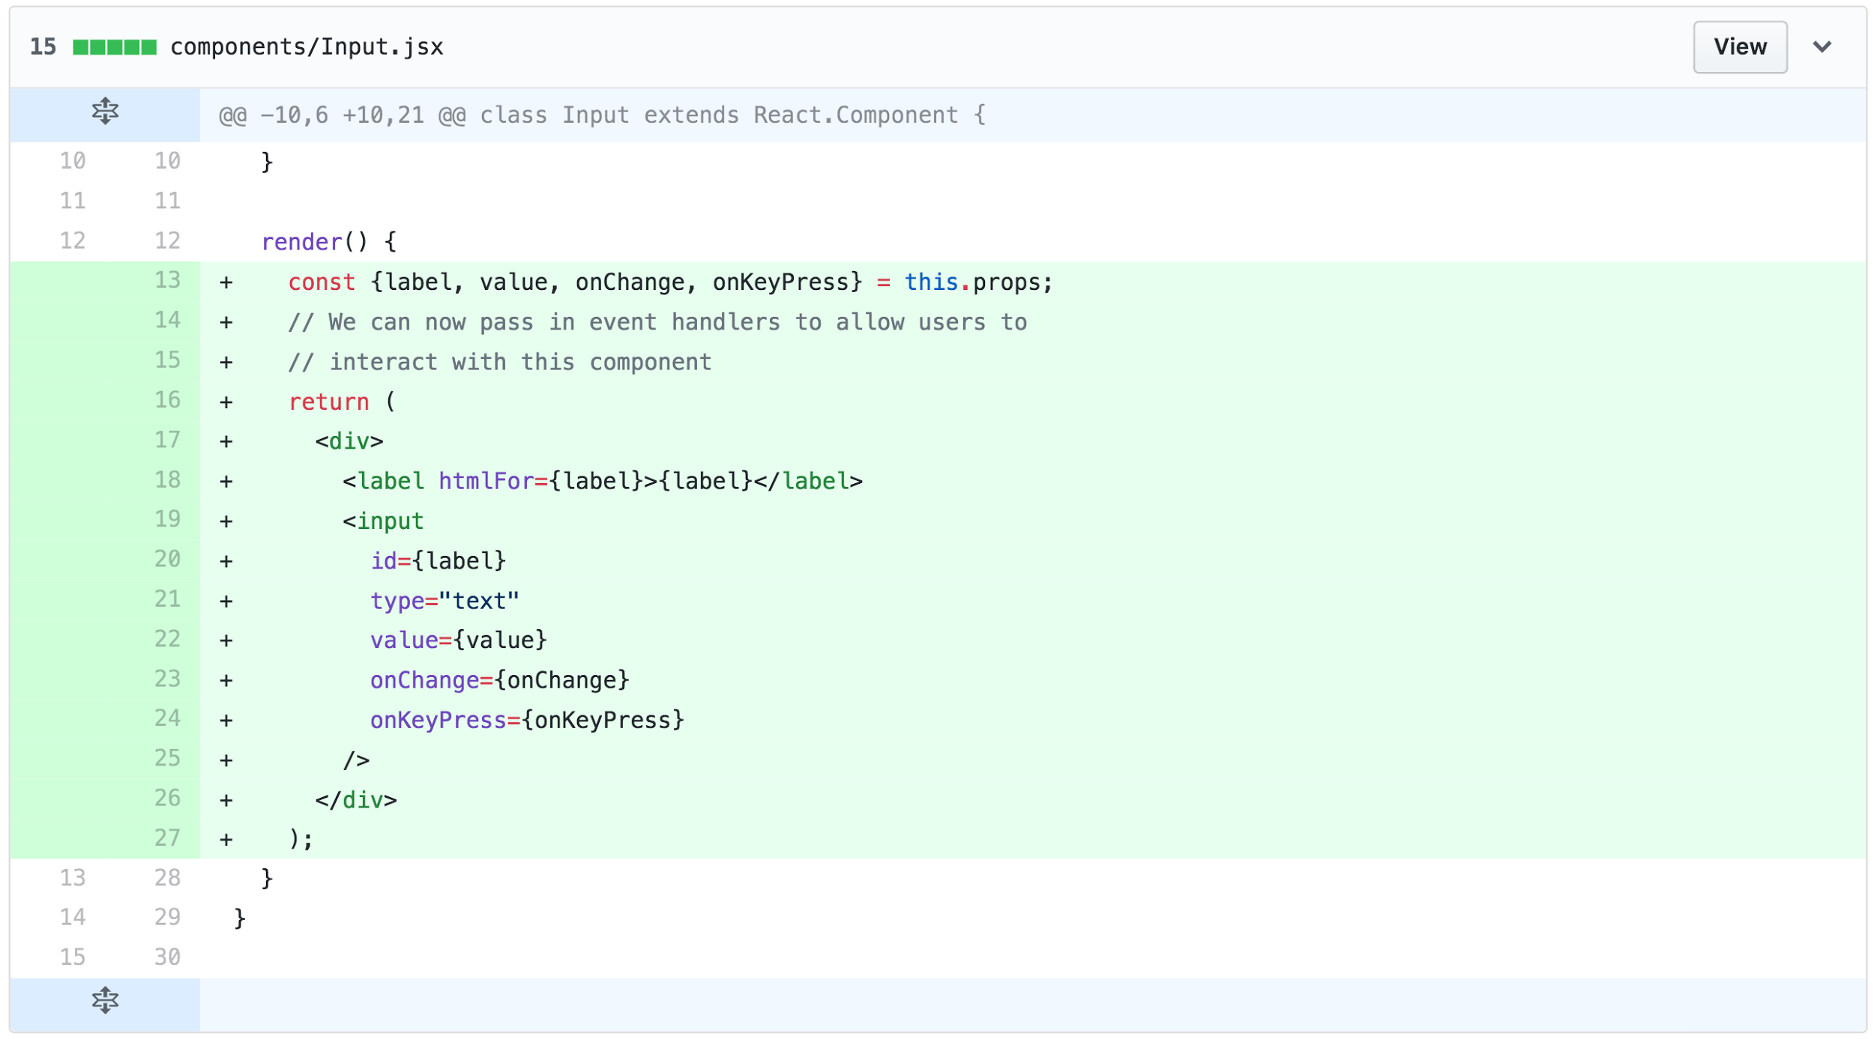
Adding New Messages
Check out all supported html events here

Slide 47
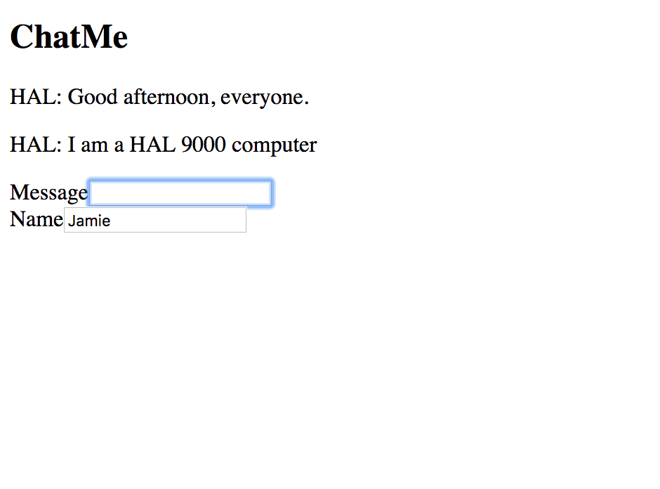
...because we’re not done!
Hold on, I can’t type anything!

Slide 48
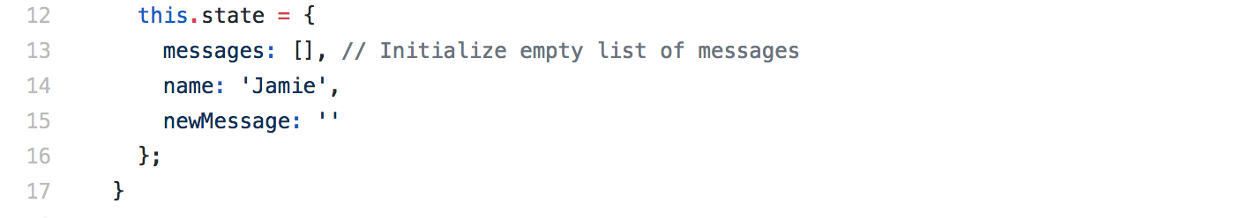

Adding New Messages
Bind functions that you pass to other components!
Otherwise they won’t work.

Slide 49
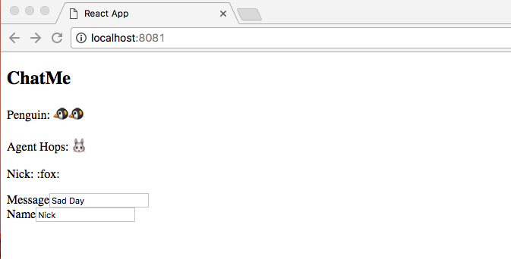
Adding Emoji Support

Slide 50
Adding Emoji Support
Go to your message component and add the library.
See the changes here!
Try:
:thumbsup:
:panda_face:
:money_with_wings:
:alien:
:speedboat:
link to more emojis

Slide 51
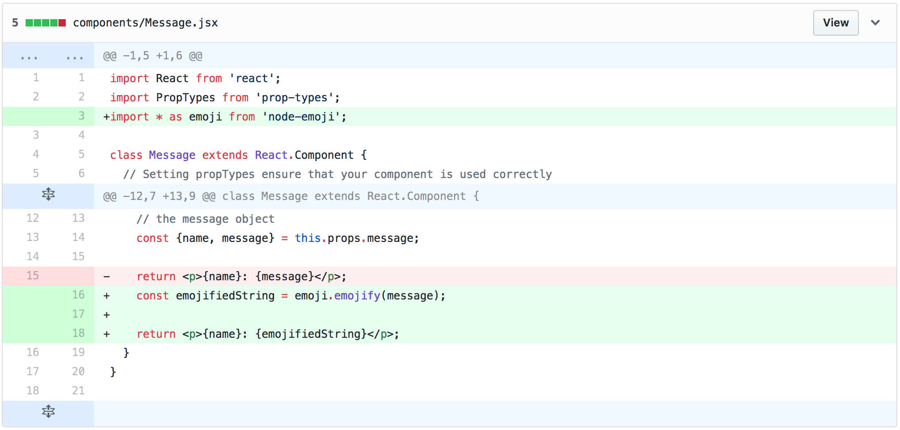
Adding Emoji Support

Slide 52
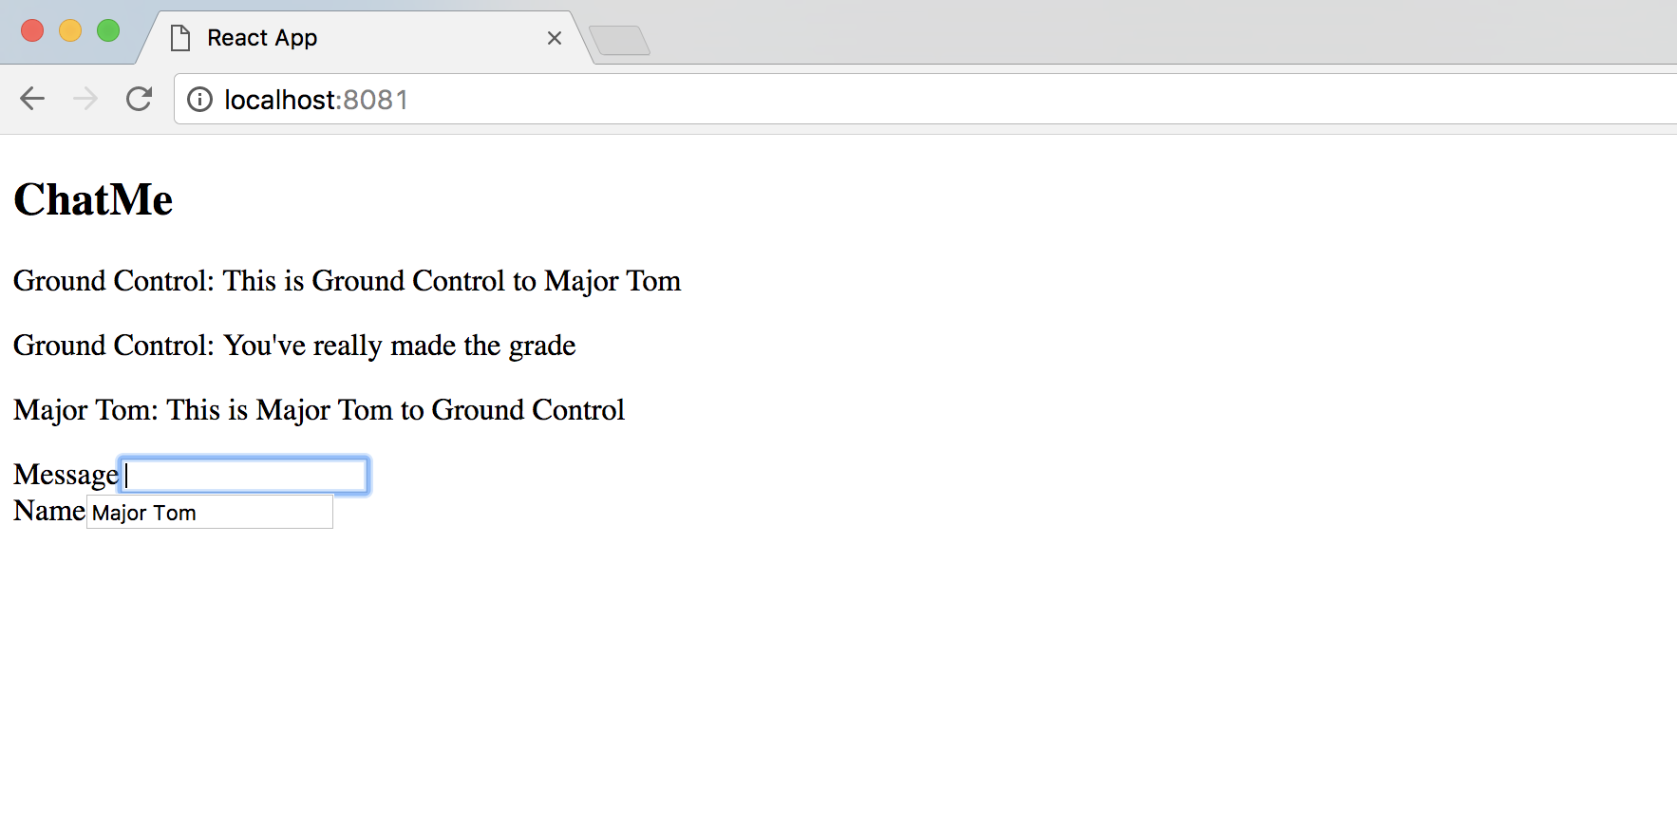
Connecting to Firebase

Slide 53
Connecting to Firebase
Open up firebase-wrapper.js. Right now we are storing messages you send in an array. We are going to delete that code and uncomment the code that puts and pulls messages from firebase.
See the changes here!

Slide 54
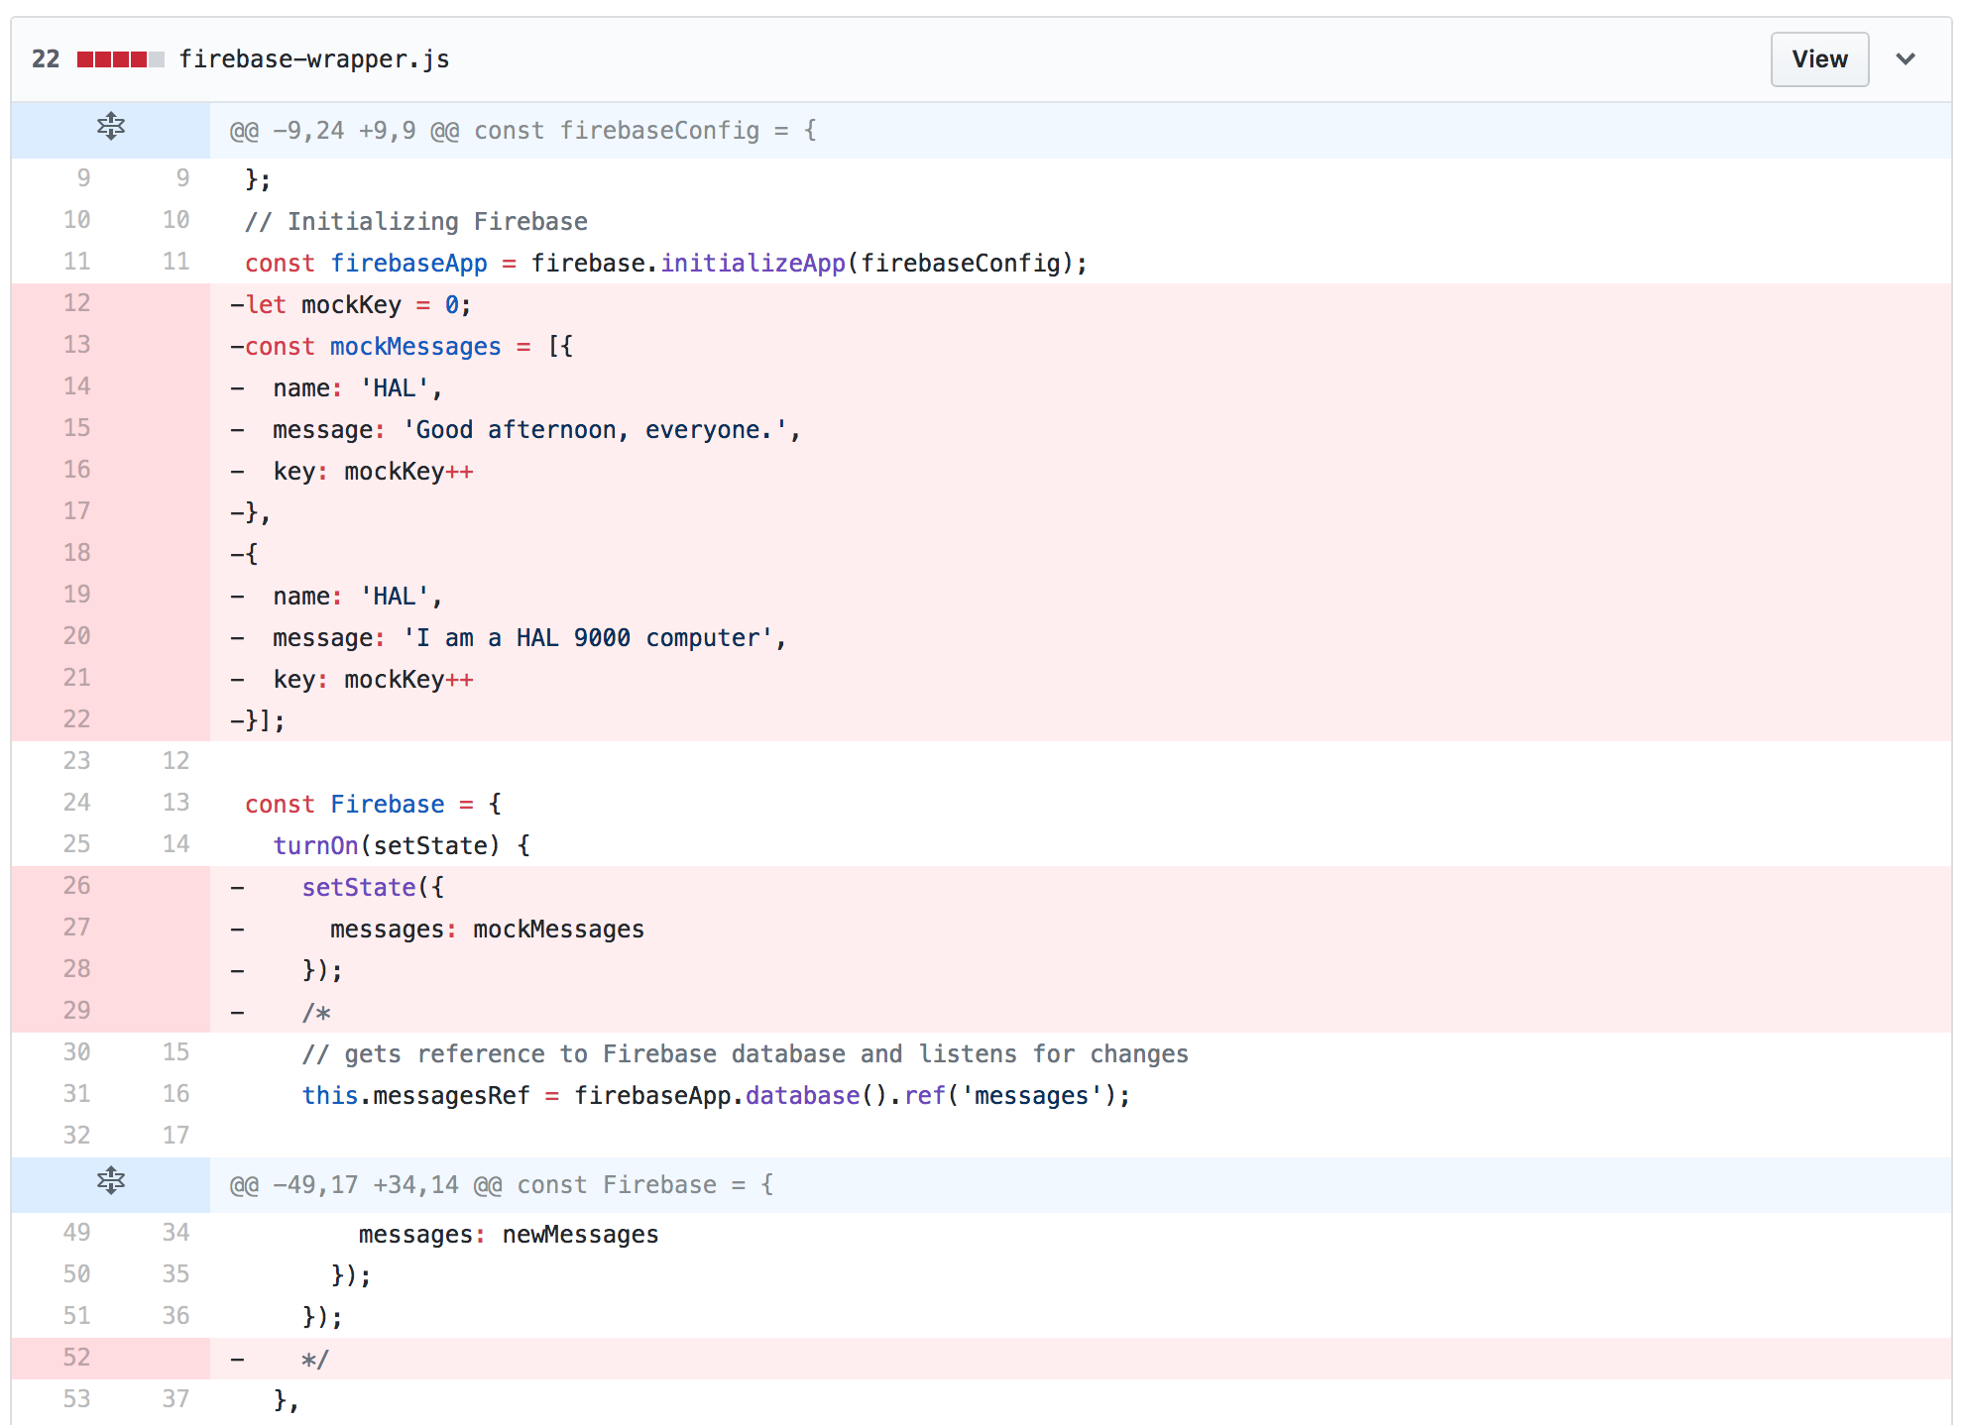
Connecting to Firebase

Slide 55
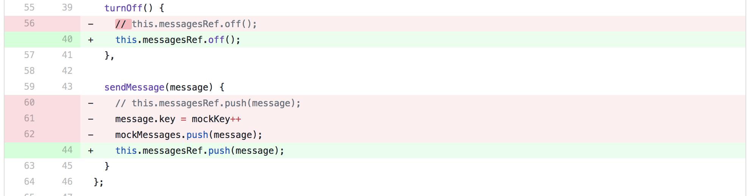
Connecting to Firebase

Slide 56
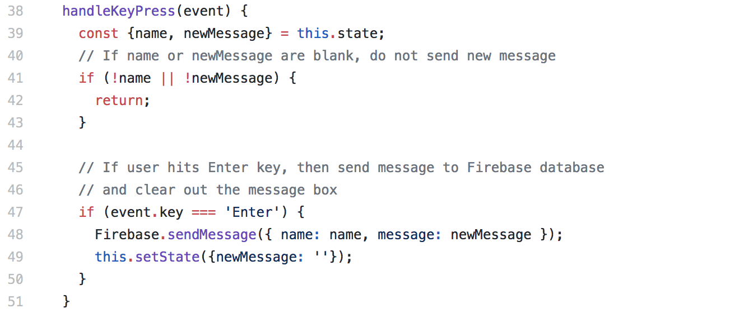
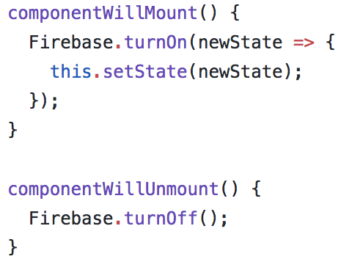
Connecting to Firebase - App.jsx

Slide 57
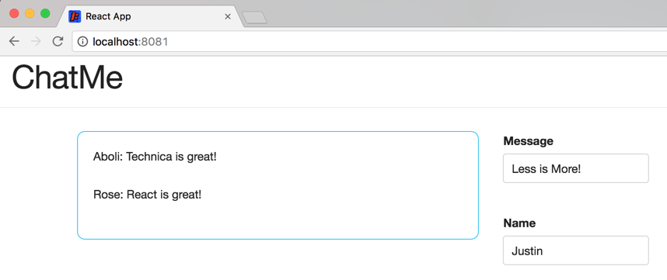
Styling our Interface

Slide 58
Styling our Interface
Our stylesheet is already included in the styles/ directory
Let’s import it and update our components to use the styles.
See the changes here!

Slide 59
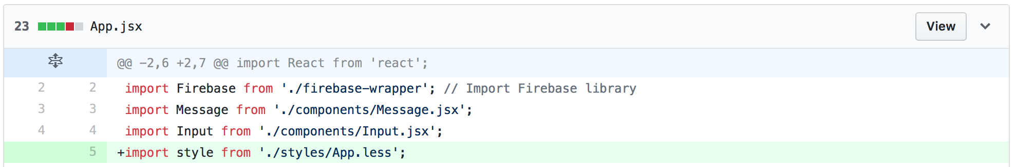
Styling our Interface

Slide 60
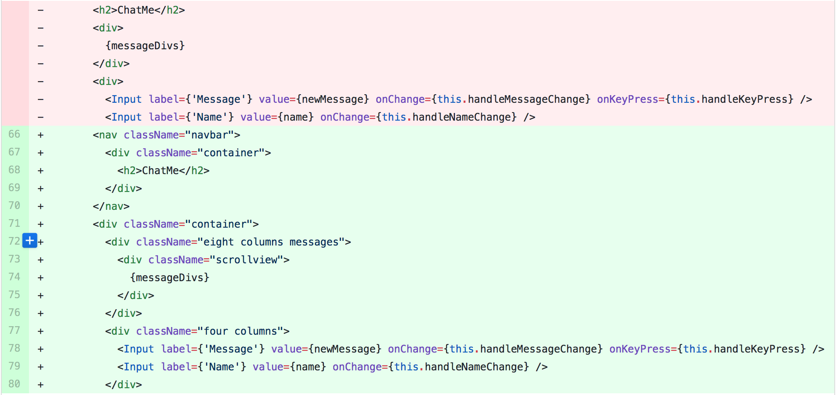
Styling our Interface

Slide 61
You're Done!
Everything Should Work Now!

Slide 62
Final Interlude, = vs == vs ===
JavaScript has three different ways to use the equality operator
A = B
Assigns the value of B as A
A == B
Asserts that A is equal to B
A === B
Asserts that A is equal to B, and checks for variable type
When in doubt, use ===!
1 == '1' | True
1 === '1' | False
Notes:
Also checks the type.
Use === as a default

Slide 63
More Common React/JS mistakes
Missing imports
Forgetting to install libraries before using them
Not updating the state using setState on user interaction
Check out this video
Notes:
Link to handout: https://docs.google.com/document/d/1PFxSwu9vYmv1dOBGvVwo4xHQJ82-fv8E83LvsqO2VqQ/edit

Slide 64
Questions?

Slide 65
Github Setup
In order to get the entire project your device, run the following command:
git clone git@github.com:FuadBalashov/ReactWorkshop.git
If you want to follow along with the slides, run the following command, which will set your project to the beginning.
git checkout da6543ac113e0292e77d8570e0b94ef8ece4663e
As we move through the workshop, we will show the necessary changes needed for each step of the project. Please feel free to code with us or just listen.
If you just choose to listen, the next slide provides git commands to keep your code up to date as we move through the presentation. Each command is coupled with the title of where we are in the workshop.
Notes:
Link to handout: https://docs.google.com/document/d/1PFxSwu9vYmv1dOBGvVwo4xHQJ82-fv8E83LvsqO2VqQ/edit

Slide 66
Git hashes
Git Command | Workshop Stage
git checkout da6543ac113e0292e77d8570e0b94ef8ece4663e | Starter Project
git checkout 843430c80affd1ce1e06b711215c0e48f9f07385 | Show the Mock Messages
git checkout 07594b3639dd8384d6c8a625951a8861abe763f7 | Making a Component
git checkout 0f599b3520be0aed92abd86fb9489993881696f4 | Adding New Messages
git checkout 935d724cd67028dd2f42556e408faf69ab386b03 | Adding Emoji Support
git checkout 54c1f6acee633a26c6b5be55125015034d190917 | Connect to Firebase
git checkout 63045bc9d64d80a6a172077764727b5ac81ee338 | Styling the Interface

